Slide 1
Machine Learning
Machine Learning enables a system to learn from experience and improve decisions automatically.

Slide 2

You watch 3 cooking videos on YouTube. Next day, your home page is full of cooking videos without you searching.
System learned your interest.

Slide 3
Supervised Learning
Learning using data where correct answers are already known.

Slide 4
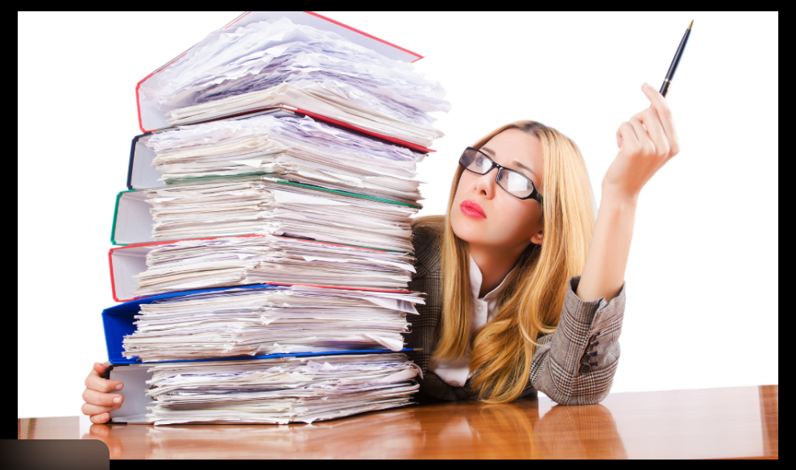
A teacher gives question + answer sheet to students. Students learn how to solve similar questions in the exam.
Model learns from labeled data.

Slide 5
Unsupervised Learning
Finding hidden patterns when no answers are given.

Slide 6
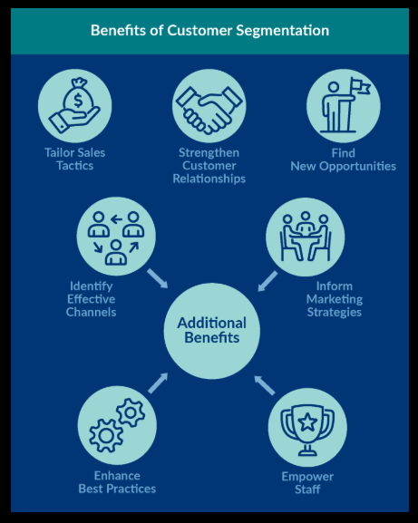
A shop owner has 100 customers but no labels. System automatically groups them as:
frequent buyers
occasional buyers
one-time buyers
Model finds patterns on its own.

Slide 7
Reinforcement Learning
Learning by taking actions and receiving rewards or penalties.

Slide 8
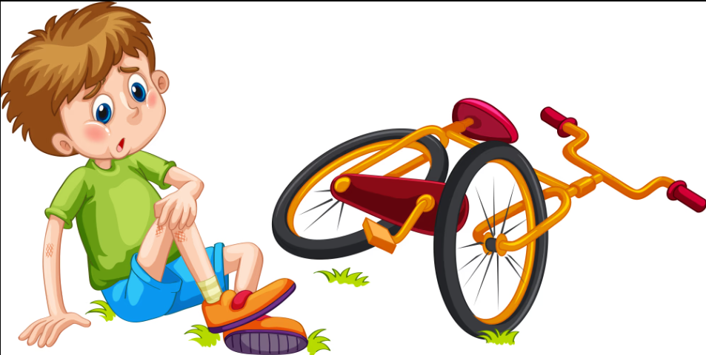
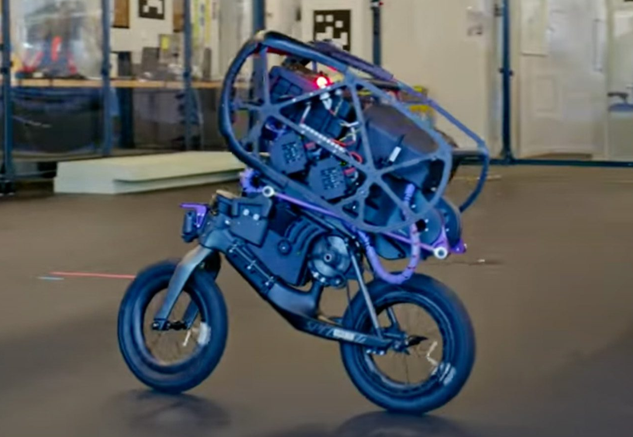
A child learns cycling:
falls → pain ❌
balances → praise 🎉
After many tries, child rides perfectly.
Learning by reward and punishment.

